Slide 1
Direct Imaging Circumstellar Debris Disks with the Gemini Planet Imager
Kadin Worthen (Senior)
School of Earth and Space Exploration at Arizona State University
Advisors: Jennifer Patience and Justin Hom
April 17, 2021
Image Credit: NASA

Slide 2
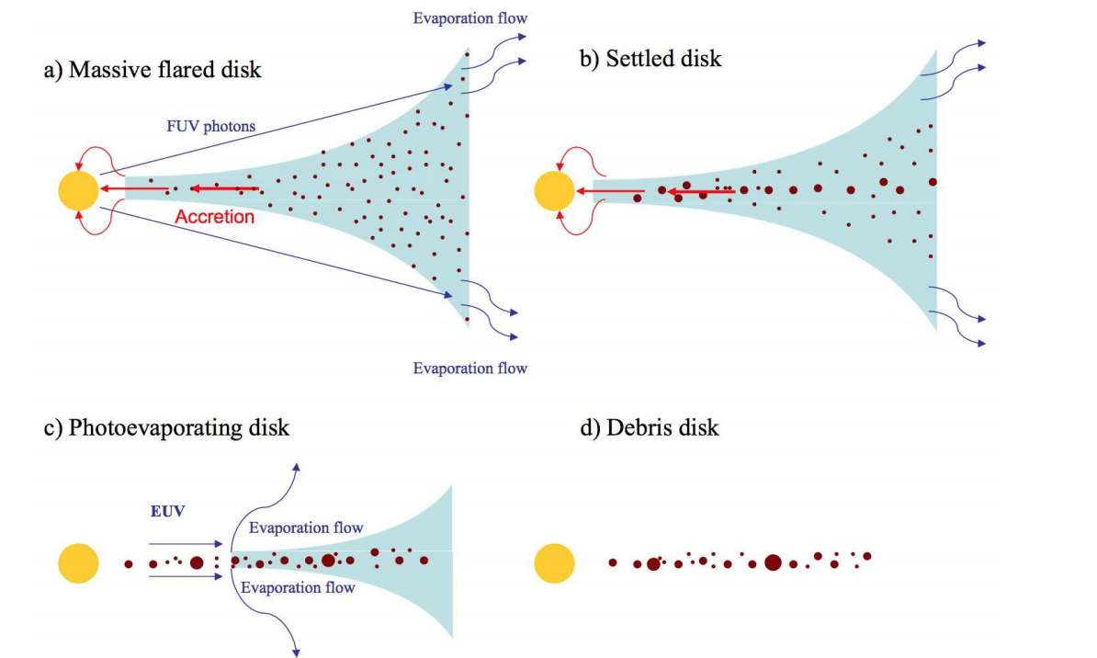
What are Debris Disks?
They consist of dust particles and planetesimals in orbit around a star.
Analogous to the Kuiper Belt in our Solar System
Thought to be remnants of the planet formation process and are replenished by collisions
Credit: Williams and Cieza (2011)

Slide 3
Motivation of Project
Images are needed to study the disk structure
Gaps or asymmetries in disks can indicate the presence of planets
Large planets in disk systems can be directly imaged
Since disks are much fainter than their stars, an instrument like the Gemini Planet Imager (GPI) must be used to image disks
Gemini South Telescope
Beta Pic Debris Disk
Credit: Gemini
Credit: Lagrange et al. (2008)

Slide 4
Target Stars
We use GPI to search for debris disks and directly imaged planets around A/F stars in Scorpius-Centaurus (Sco-Cen), the nearest OB association.
Sco-Cen has shown to be a rich laboratory for studying disks and planet formation
All target stars are more massive than our sun.
Credit: Hom et al. 2020

Slide 5
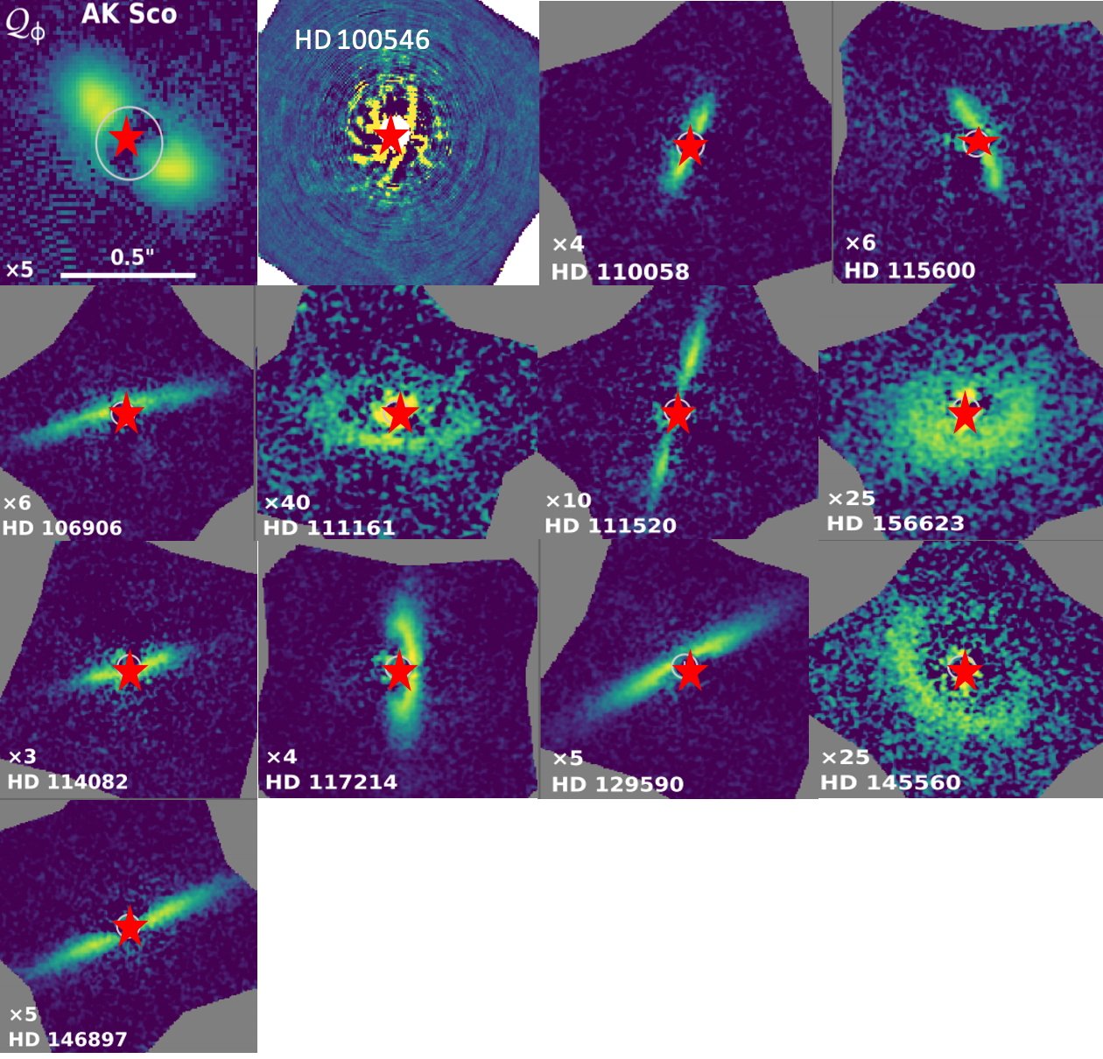
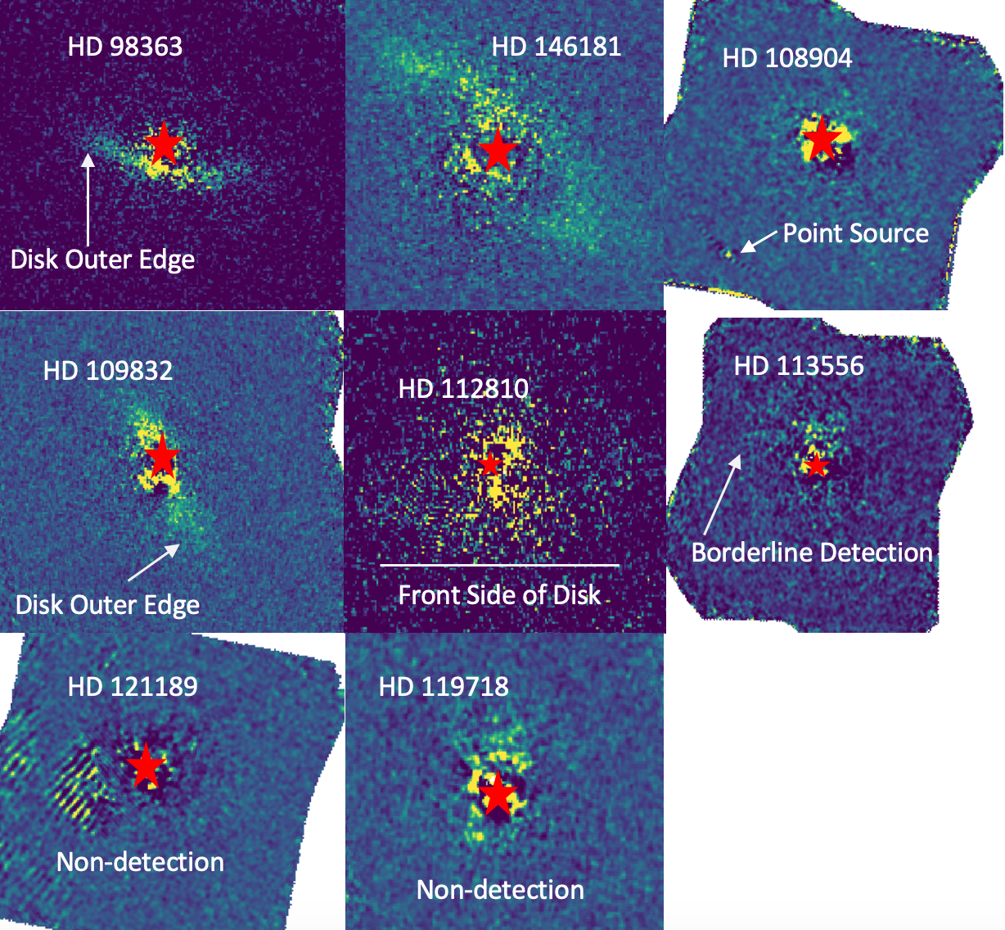
Disk Detections
Credit: Esposito et. al. 2020

Slide 6
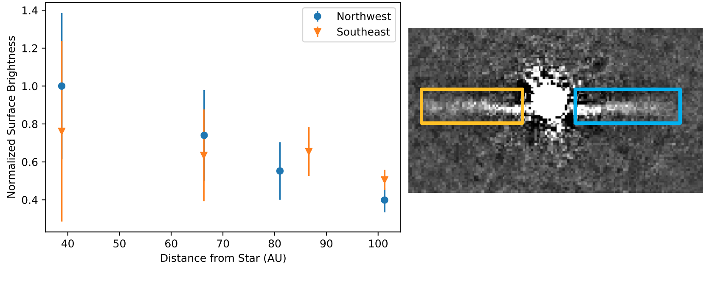
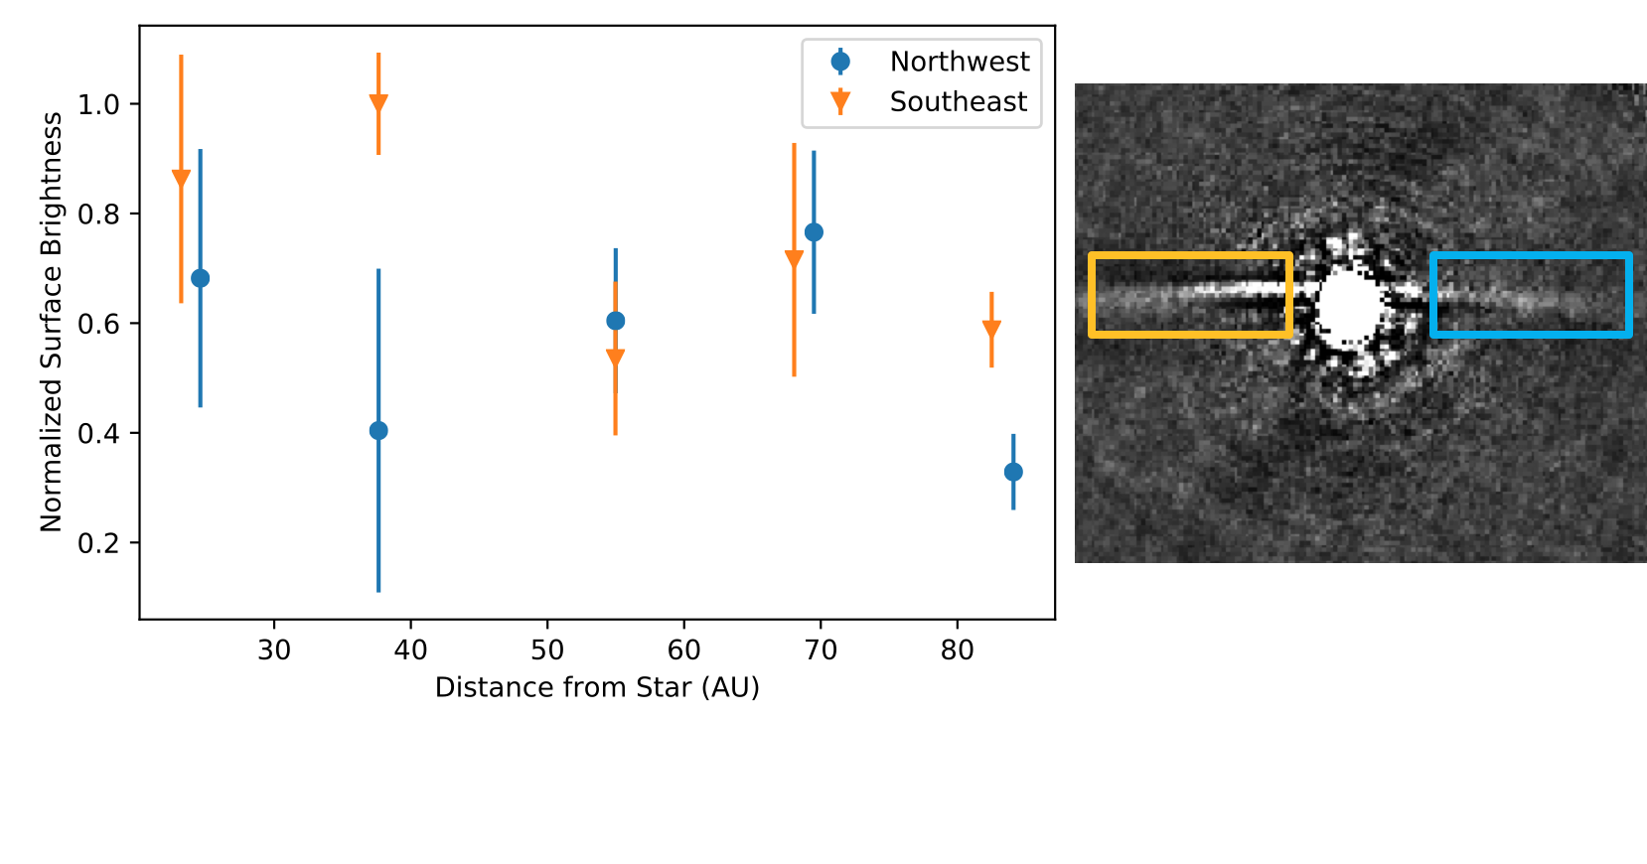
Surface Brightness Profiles
We measure disk surface brightness as a function of distance from the star for four disks
We find that three have symmetric surface brightness profiles
HD 106906 has an asymmetric surface brightness profile
HD146987
HD 106906

Slide 7
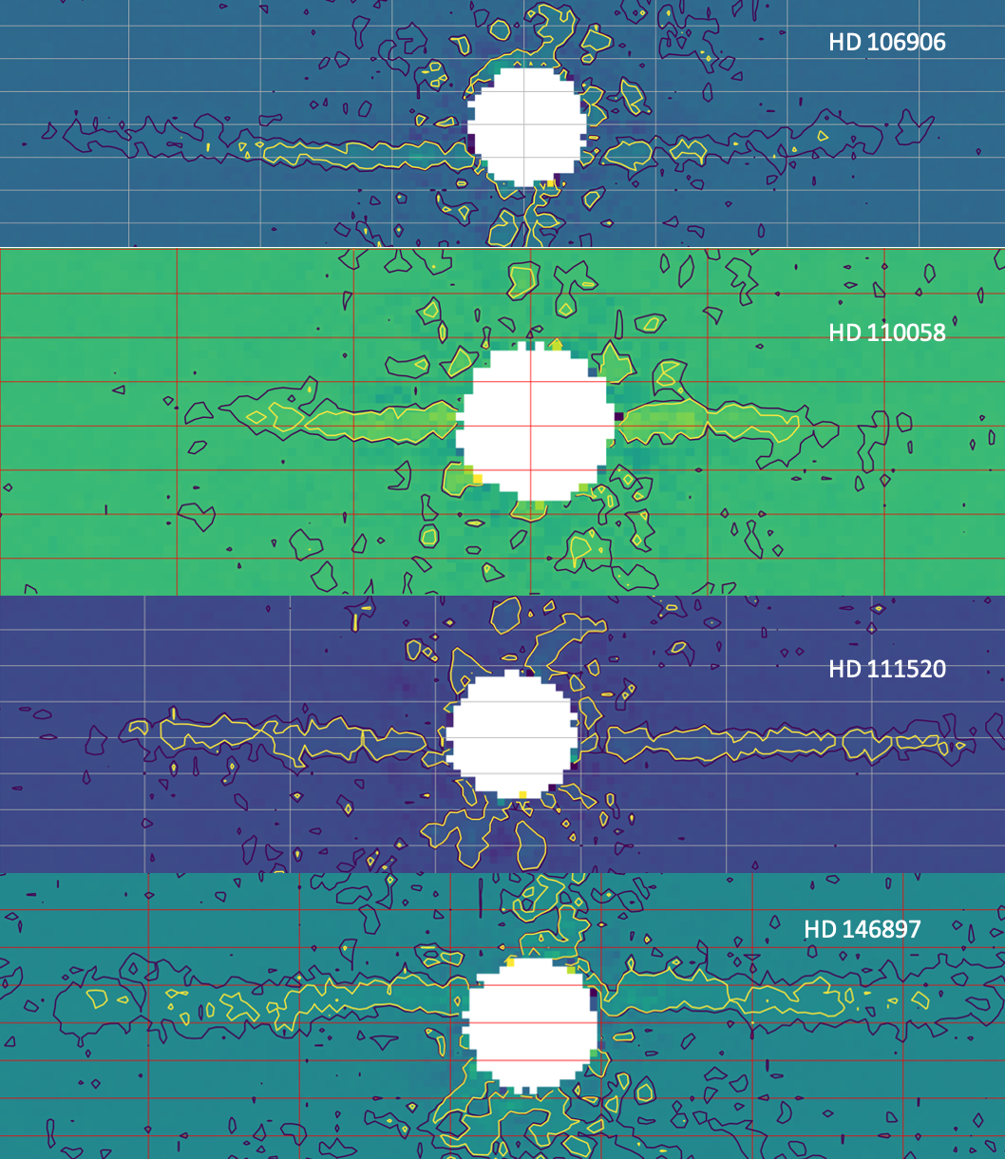
Radial Extent Asymmetries
We look to see if the edge-on disks have asymmetries in their radial extents.
We find that two disks have asymmetries in their radial extent, HD 106906 and HD 111520.

Slide 8
Conclusions
We resolve debris disks with a variety of morphologies in Sco-Cen with the Gemini Planet Imager
We identify o a point source around HD 108904 as a candidate companion
We measure the surface brightness profiles of 4 edge-on debris disks and find that 1 of them has asymmetries
Two of the edge-on disks are asymmetric in radial extent.

